Slide 1
ANN/CNN/RNN

Slide 2
Steps of Implementation

Slide 3
Artificial Neural Network
Architectural Components

Slide 4
Introduction
ANNs are considered as nonlinear statistical data modeling tools where the complex relationships between inputs and outputs are modeled or patterns are found. It is based on structures and functions of biological neural networks.
Basic Building Blocks
Neurons
Layers - Input, Output and Hidden
Weights
Bias
Activation function
Forward Propagation
Learning Rate
Batches
Epochs
Iterations
Backward Propagation
Cost Function
Gradient Descent

Slide 5
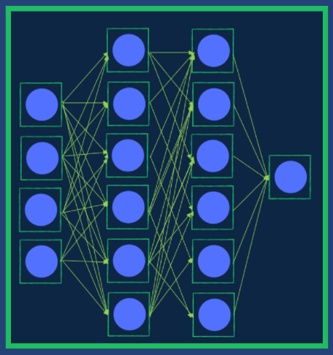
Architectural Components
Neuron
A Neural Network in made of an artificial interconnectors called a s Neurons. They are the building block of the Neural Networks like the biological neuron of the human brain cells.
The idea is to replicate an abstracted understanding of how we believe the human brain might process similar information and learn from its surroundings and sensory input.

Slide 6
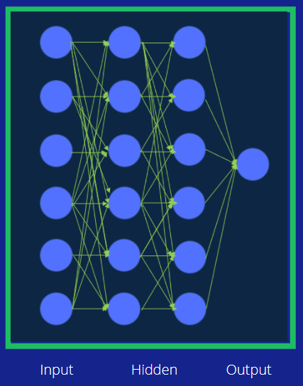
Layers
An Artificial Neural Network is made up of 3 components or interconnected layers namely
1. Input Layer
2. Hidden (computation) Layers
3. Output Layer

Slide 7
Input Layer :
They receive input from an external source or other nodes.
Each node is connected with another node from the next layer, and each such connection has a particular weight. Weights are assigned to a neuron based on its relative importance against other inputs.
Hidden (Computation) Layers :
Hidden layers reside in-between input and output layers and this is the primary reason why they are referred to as hidden.
The word “hidden” implies that they are not visible to the external systems and are “private” to the neural network.
Output Layer :
The output layer is responsible for producing the final result. There must always be one output layer in a neural network.
The output layer takes in the inputs which are passed in from the layers before it, performs the calculations and then the output is computed.

Slide 8
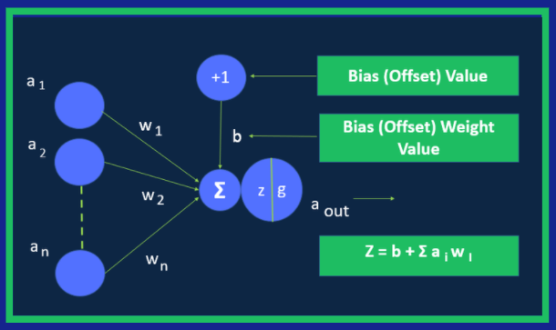
Weight & Biases
Weight : Weights control the signal (or the strength of the connection) between two neurons. In other words, a weight decides how much influence the input will have on the output.
Bias : Biases, which are constant, are an additional input into the next layer that will always have the value of 1. Bias units are not influenced by the previous layer (they do not have any incoming connections) but they do have outgoing connections with their own weights. The bias unit guarantees that even when all the inputs are zeros there will still be an activation in the neuron.

Slide 9
Activation Function
An activation function is a function that is added into an artificial neural network (ANN) in order to help the network learn complex patterns in the data.
When comparing with a neuron-based model that is in our brains, the activation function is at the end deciding what is to be fired to the next neuron. That is exactly what an activation function does in an Artificial Neural Network (ANN) as well. It takes in the output signal from the previous cell and converts it into some form that can be taken as input to the next cell.
It is the Activation function that induces non-linearity in the network so that the model understands the complex pattern in the dataset.
A neural network without an activation function is essentially just a linear regression model.
We use a non linear transformation to the inputs of the neuron and this non-linearity in the network is introduced by an activation function

Slide 10
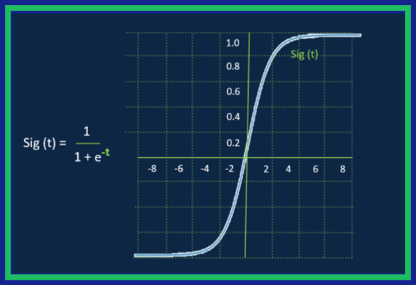
Sigmoid Activation Function
It is one of the most widely used non-linear activation function. Sigmoid transforms the values between the range 0 and 1.
A noteworthy point here is that unlike the binary step and linear functions, sigmoid is a non-linear function.
This essentially means when I have multiple neurons having sigmoid function as their activation function, the output is non linear as well..

Slide 11
Forward Propagation
From the word Forward Propagation forward implies moving ahead and propagation is a term for saying spreading of anything. forward propagation means we are moving in only one direction, from input to the output, in a neural network.
Think of it as moving across time, where we have no option but to forge ahead, and just hope our mistakes don’t come back to haunt us.
In other words Forward propagation (or forward pass) refers to the calculation and storage of intermediate variables (including outputs) for a neural network in order from the input layer to the output layer.

Slide 12
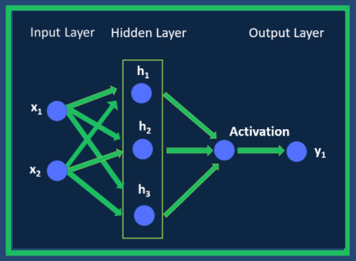
Forward Propagation
From the word Forward Propagation forward implies moving ahead and propagation is a term for saying spreading of anything. forward propagation means we are moving in only one direction, from input to the output, in a neural network.
Think of it as moving across time, where we have no option but to forge ahead, and just hope our mistakes don’t come back to haunt us.
In other words Forward propagation (or forward pass) refers to the calculation and storage of intermediate variables (including outputs) for a neural network in order from the input layer to the output layer.

Slide 13
Learning Rate
The amount that the weights are updated during training is referred to as the step size or the “learning rate.”
Specifically, the learning rate is a configurable hyperparameter used in the training of neural networks that has a small positive value, often in the range between 0.0 and 1.0.
The learning rate controls how quickly the model is adapted to the problem. Smaller learning rates require more training epochs given the smaller changes made to the weights each update, whereas larger learning rates result in rapid changes and require fewer training epochs.
A learning rate that is too large can cause the model to converge too quickly to a suboptimal solution, whereas a learning rate that is too small can cause the process to get stuck.

Slide 14
Batches, Epochs and Iterations
Batches:
The Batch Size is a number of samples processed before the model is updated.
The size of a batch must be more than or equal to one and less than or equal to the number of samples in the training dataset.
Epochs:
The number of epochs is the number of complete passes through the training dataset.
The number of epochs can be set to an integer value between one and infinity. You can run the algorithm for as long as you like and even stop it using other criteria besides a fixed number of epochs, such as a change (or lack of change) in model error over time.
Iterations:
Iterations is the number of batches needed to complete one epoch. Example When We can divide the dataset of 2000 examples into batches of 500 then it will take 4 iterations to complete 1 epoch. The Batch Size is 500 and Iterations is 4, for 1 complete epoch.

Slide 15
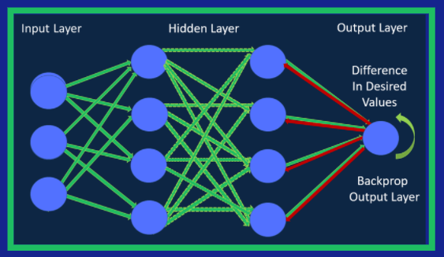
Backward Propagation
Back-propagation is the essence of neural net training.
It is the method of fine-tuning the weights of a neural net based on the error rate obtained in the previous epoch (i.e., iteration). Proper tuning of the weights allows you to reduce error rates and to make the model reliable by increasing its generalization.
Backpropagation is a short form for "backward propagation of errors." It is a standard method of training artificial neural networks. This method helps to calculate the gradient of a loss function with respects to all the weights in the network.

Slide 16
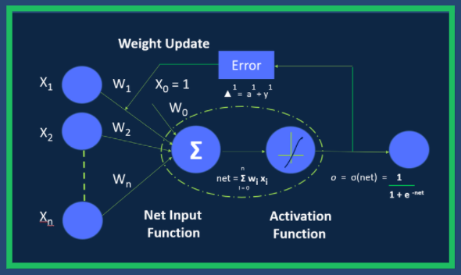
Cost Function
A cost function is a measure of error between what value your model predicts and what the value actually is. For example, say we wish to predict the value yi for data point xi.
A cost function represents the prediction or output of some arbitrary model for the point xi with parameters θ.
One of the many cost functions could be L2 loss. Training the hypothetical model we stated above would be the process of finding the θ that minimizes the Sum

Slide 17
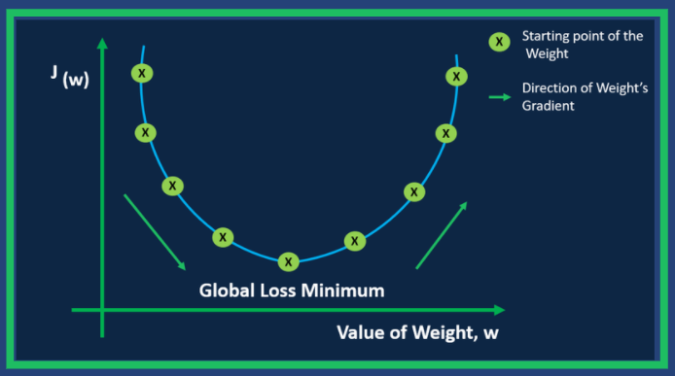
Gradient Descent
Gradient Descent is a process that occurs in the backpropagation phase where the goal is to continuously resample the gradient of the model’s parameter in the opposite direction based on the weight w, updating consistently until we reach the global minimum of function J(w).
To put it simply, we use gradient descent to minimize the cost function, J(w). The gradient descent process is exhibited in the form of the backpropagation step where we compute the error vectors δ backward, starting from the final layer.
Depending upon the activation function, we identify how much change is required by much change is required by taking the partial derivative of the function with respect to w. The change value gets multiplied by the learning rate. As part of the output, we subtract this value from the previous output to get the updated value. We continue this till we reach convergence.

Slide 18
Steps of Implementation
Step 1 : INI File Configuration
This is the first step in the implementation process. A configuration file called .INI file is configured for all the file paths, user credentials, AI Machine Learning/Deep Learning model features, lables etc are harcoded..
__________________________________________________________________________________________________________
Step 2 : Importing the Required Libraries
The next immediate step after configuring the .INI file is importing all the required libraries used in the implementation Process. In Our Implementation we are using the following ML/DL libraries:
__________________________________________________________________________________________________________
Step 3 : Importing the Training Data
Next immediate step after importing all libraries is getting the Training data imported. We are importing the Training data stored in our local system with the use of Pandas library
__________________________________________________________________________________________________________

Slide 19
Steps of Implementation
Step 4: Creating the model using the sequential class (Linear stack of layers)
After we import the training data, the next step is to create a keras sequential model. This is where the configuration of the Neural Network layers take place aka Input layer, hidden layer, and output layer.
__________________________________________________________________________________________________________
Step 5: Train the Model
After the sequential model is created with the neural network layers, the next immediate step is to train the model on out input data. It is through the training process that our sequential model understands the input, learns the patterns in the datasets and does the prediction.
__________________________________________________________________________________________________________

Slide 20
Steps of Implementation
Step 6: Import the Test Data
Test data is the dataset used to test on how the model performs on a new unseen dataset. Its imported from the local system and given as input to the model for prediction.
__________________________________________________________________________________________________________
Step 7: Run the Prediction
After importing the test data, it is fed to the trained model that has been trained on the datasets to learn the features and understand the patterns in the datasets. Now the trained model takes this test data as input and does the prediction based on it learning. Once the prediction has been made the model is validated for its prediction accuracy.
__________________________________________________________________________________________________________
Step 8: Writing the model Outcome to a file
The predicted outcome of the model is written in persistent storage like an excel file or a csv file for data analysis or it could be used to train the next model used for an another prediction.

Slide 21
Convolutional Neural Networks
Architectural Components

